Slide 1
ALPhA Week 5: (2/15/19 – 2/22/19)
Gray Selby
AT-TPC Alpha – Alpha Classification

Slide 2
Week 5
Set out to determine how we will determine if a pad has a ‘hit’ from a charged particle
Made histograms of charge values across all pads and for each event
These ended up not being very informative, especially as the pad plane turned out to be normalized by pad plane section
I then began plotting the trace for the 512 time buckets for each pad
Found that the first and last 5 time buckets often had strange jumps in charge that don’t seem to be from charged particles
I noticed that few traces had charge values over 800 which could be useful
I marked these traces in red

Slide 3
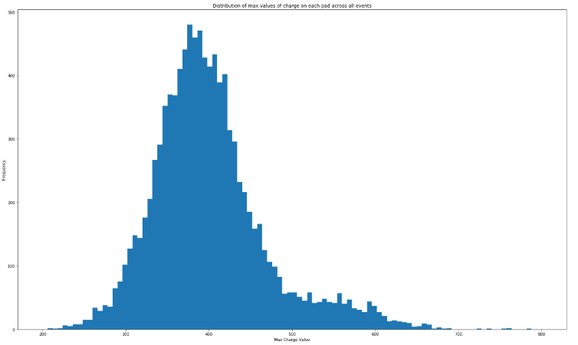
Trace charge values across all pads
This shows that the charge values range from about 200 to 800 with the majority at about 375.
The histogram is skewed to the right which is a good sign.
Actual ‘hits’ from charged particles must be around a charge value of 500.

Slide 4
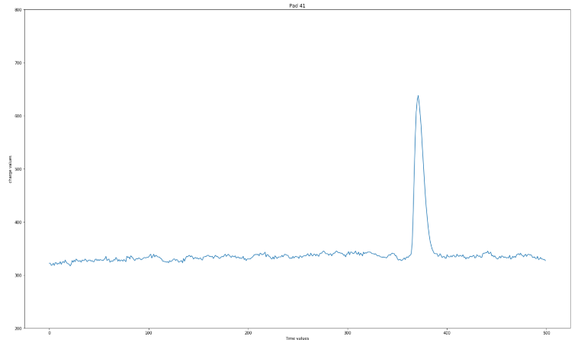
Charge trace for pad 41 (Event 1)

Slide 5
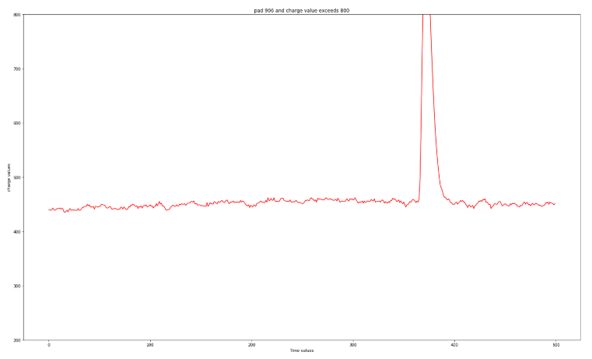
Charge trace for pad 905 (Event 1)
This trace is unique in that its peak is greater than 800
Notice that the average of the trace is particularly high due to pad section normalization in this experiment

Slide 6
Week 5
A threshold value of 500 adequately filters out pads although this is certainly not the most accurate method, we need to keep computation times down since each event has 10240 pads and we will want to process many events with whatever method we choose.

